Slide 1
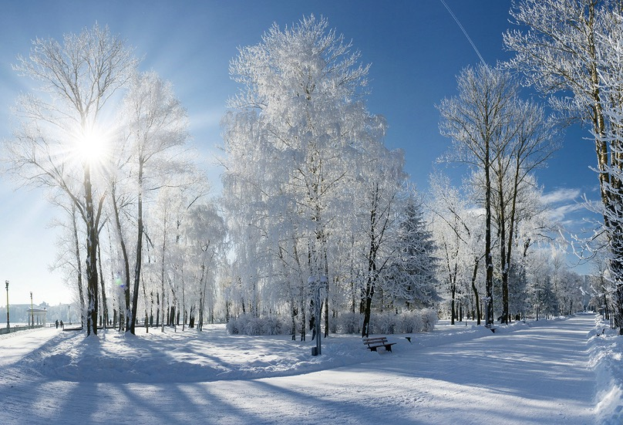

Preparing for a Canadian Winter
By: Adam Read & Jenna Pinkney

Slide 2

Quick Discussion
Who has experienced Winter before?
What do you already know about Winter?

Slide 3
Canadian Winter
Coldest season of the year
December 21st - March 20th
Cold weather can start in October and last until April
Days become shorter - becomes dark out earlier

Slide 4
Temperatures in Windsor
On an average of 116 days a year the temperature is at or below 0°C
Coldest nights can have lows in the -20’s°C (rare)
Windsor is surrounded by lakes - therefore the temperature feels even colder due to the amount of moisture in the air​

Slide 5
Terms
Snow
Freezing Rain
Wind Chill Index
Ice
Black Ice
Blizzards

Slide 6
Snow
Snowflakes are clusters of ice crystals that form when precipitation (rain) reaches freezing temperature (0°C or below)​ and falls from a cloud

Slide 7
Freezing Rain
Precipitation that falls as a supercooled water droplet until it strikes a cold surface, at which point it freezes almost instantly

Slide 8
Wind Chill
Is the temperature your body feels when the air temperature is combined with the wind speed
As wind speed increases, it can carry heat away from your body much more quickly, causing skin temperature to drop

Slide 9
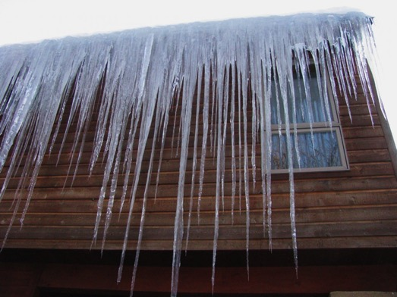
Ice
Can form anywhere when water freezes over
Can form as icicles on trees, houses, etc.

Slide 10
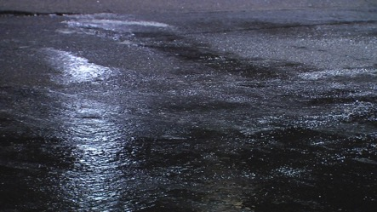
Black Ice
Very slippery layer of ice!
Usually forms with a sudden increase and decrease in temperature
Causes snow on roads, sidewalks and driveways to melt and re-freeze quickly
Also forms when snow or light rain falls on frozen concrete, turning it into a thin layer of ice on contact​
Black ice can look like wet concrete or pavement but it is much more slippery!

Slide 11
Blizzard
Is a severe snow storm with very strong winds
May experience very high winds and whiteouts (snow blowing everywhere)
Snow accumulation can be significant
It becomes difficult to walk and drive - it is advised to stay inside if possible
Rarely happens in Windsor but can be dangerous
If you live off campus - ask your landlord who is responsible for shovelling your walkway and driveway

Slide 12
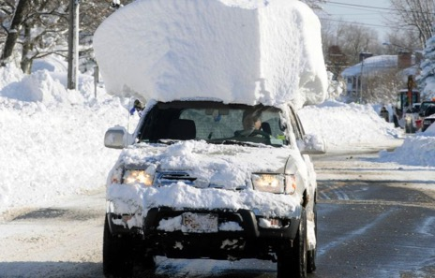
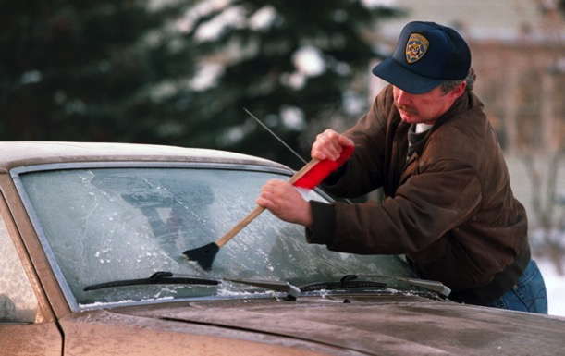
Driving Safety
Stay alert. Slow down. Stay in control.
Drive according to road conditions
Clear snow and ice before driving
Consider winter tires
Leave space, do not tailgate

Slide 13
Biking Safety
Stay where the snow has been plowed
Slow down and stay alert for ice patches
Use rear breaks only to avoid sliding out
WATCH OUT - cars are less aware of bikers in the winter
Use lights and reflectors on the front and back of your bike
Alternate tires - some have a wider tube, others have spikes
Dress warm - extra layers help protect from the wind while riding

Slide 14
Clothing
Layers! Layers! Layers!
Hats (touques)
Gloves/Mittens
Scarves
Coats
Long Underwear
Boots
Socks

Slide 15
Good Brands

Slide 16
Where to Shop
Devonshire mall: Boathouse, Hudson’s Bay, Sport Check
Winners
Joe Fresh (The Real Canadian Superstore)
Walmart

Slide 17
Cheaper Alternatives
STK Thrift Store
Value Village
Goodwill
Facebook (Marketplace)

Slide 18
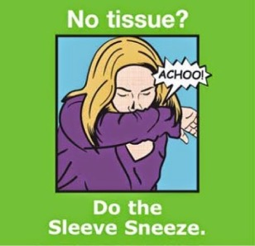
Cough & Sneeze Etiquette

Slide 19
Hand Hygiene
When to use alcohol-based hand sanitizer​:
No access to water
Hands are not visibly dirty
When to wash your hands:
Visibly dirty
After using the toilet
Before eating or handling food
After contact with contaminated surfaces (e.g., garbage bins, cleaning cloths)
After coughing or sneezing

Slide 20
Hand Hygiene
https://www.youtube.com/watch?v=3PmVJQUCm4E

Slide 21
Personal Hygiene
Despite the cold weather, your body still sweats
Body odours are caused by a combination of factors including:
Chemicals in sweat
Bacteria that live on the skin
Unwashed clothes such as underwear and socks
The food that we cook with and eat

Slide 22
Personal Hygiene
Why is it so important?
Reduce unpleasant odours
Minimize illness
Maintain professional appearance at school and work
Avoid judgment from peers and potential employers

Slide 23
Personal Hygiene
Remember that body odours are not only on the body!
Change your clothes on a daily basis
Wash clothes at least once a week
Include winter clothes in your load of wash (coats, hats, mitts, scarves, and boot liners)

Slide 24


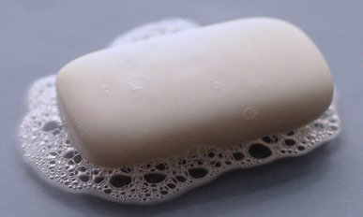
Real Shower vs.
Shower in a Can
vs.

Slide 26
Tips
Windsor is the most Southern part of Canada - remember when travelling that other parts may be much colder
Drink warm beverages - hot chocolate, hot apple cider, soup, tea or coffee
Do not leave heaters or candles unattended
Make sure your hair is dry before going outside

Slide 28
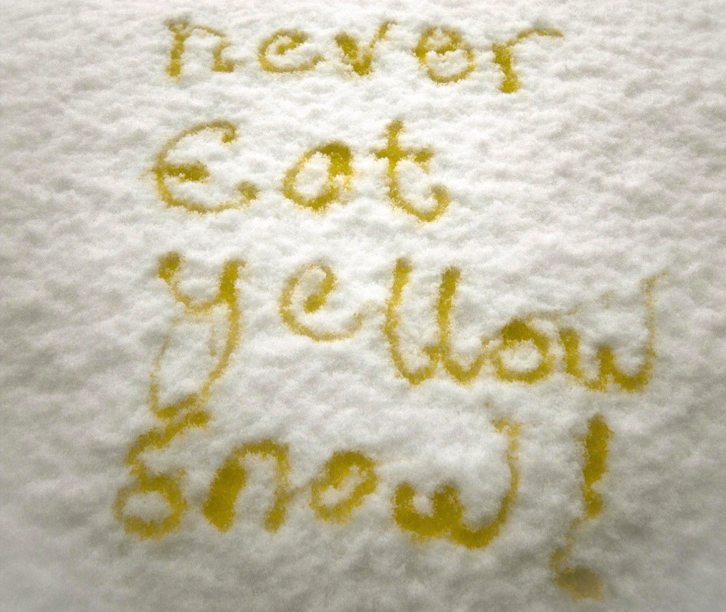

Slide 29
Tobogganing

Slide 30
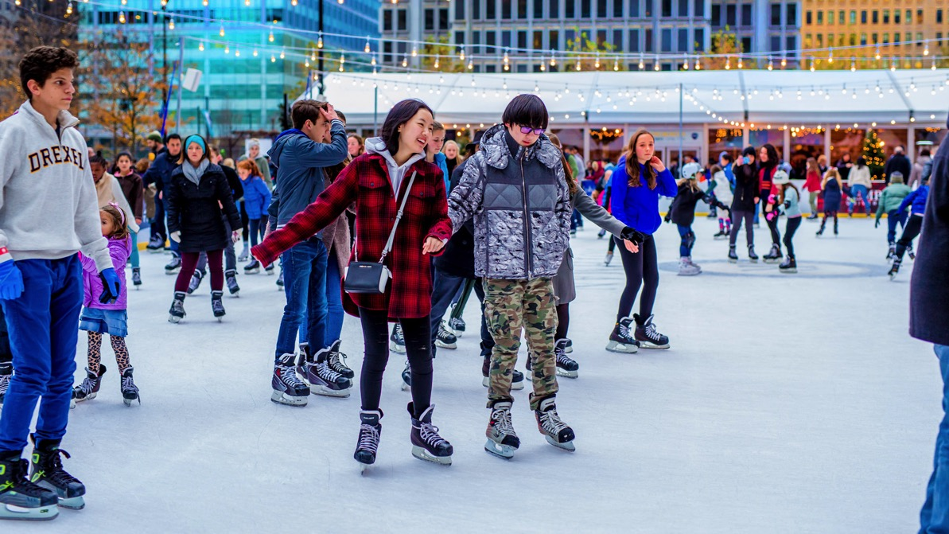
Ice Skating

Slide 31
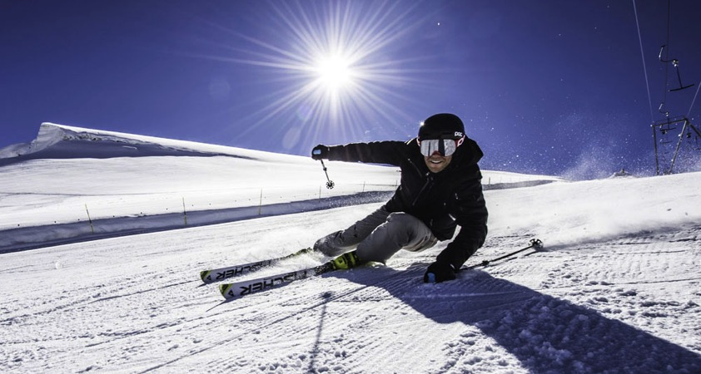
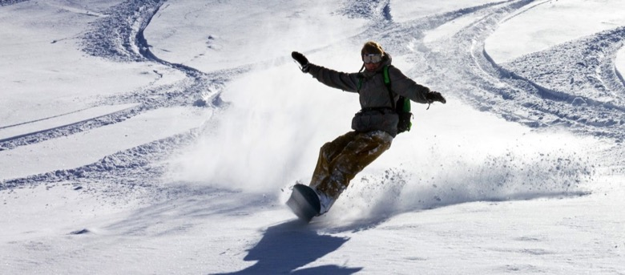
Skiing & Snowboarding

Slide 32
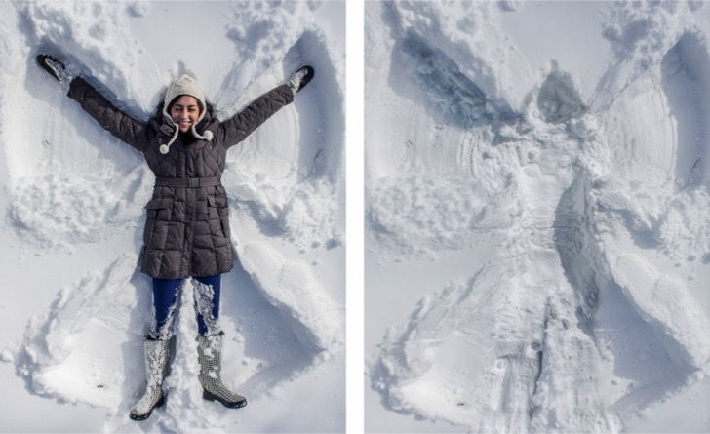
Making Snowmen & Snow Angels

Slide 33
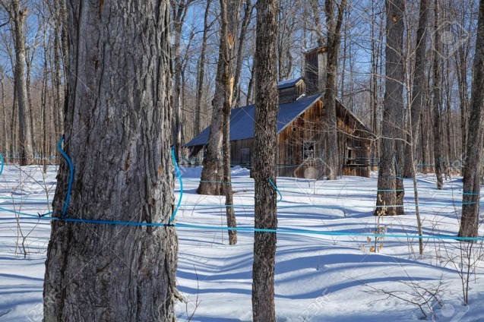
Visit a Sugar Bush

Slide 34
Summary
Winter is EXTREMELY cold
It is CRUCIAL to keep body warm during the winter
Use CAUTION when driving or biking
Personal hygiene should NOT be neglected

Slide 35
Dress the ISC Nursing Students!

Slide 36
Kahoot!
https://create.kahoot.it/kahoots/my-kahoots

Slide 37
Time for Questions!!!

Slide 38
Thank You

